Slide 1

Travel Booking
Portal
December 2022

Slide 2

Solution Summary
01
Scope
02
02
Solution
02
03
API Versioning
02
04
API Request & Response Messages
02
05
Naming convention & URL
02
06
Q&A
02

Slide 3
Scope
Objective
Scope of activities
To get quote of insurance
The travel application will send customer data (Fname, Lname, DOB, Email) and travel details (destination, departure date, return date).
API Response with Quote ID and 3 insurance option and premium for each option.
Save the policy on the basis of quote id
Save the quote by passing the quote id.
Quote confirmation in main frame system
Core system require 2 minutes to process.
Get confirm policy details from core system based on quote id & selected plan name.

Slide 4



Solution: Use Case 1– Get Insurance Quote & Save User Selection
Travel Booking
Portal
Portal
Exp API
Experience Layer
JSON Post request received from Travel Booking Portal to Experience Layer /get-insurance-quote
Information pass to process layer /quote and to System Layer /quote
System layer communicate to Insurance provider and get the quotation Id and 3 best quote
The response sent to travel booking portal.
User selects the 1 of the option and send to “quote Id” experience layer /confirm-insurance-quote.
Experience layer calls process layer /confirm-insurance-quote api
Process layer calls /confirm-insurance-quote insurance system api to update the user selection in system.
Request & response sample message refer slide 14
Policy
Process API
Quote
Process API
Process Layer
Insurance
System API
System Layer
Insurance Provider System

Slide 5
Solution: Use Case 2– Issue Confirm Policy
Travel Booking
Portal
Portal
Exp API
Experience Layer
JSON Post request received from Travel Booking Portal to Experience Layer /issue-policy
Information pass to process layer /issue-policy and business logic applied if applicable to generate policy
System Layer make a call to insurance provider api /issue-policy.
Insurance provider system called using request reply pattern using correlationId as system requires 2 minutes to process.
Once response comes from core system, a success response send to portal with quoteId , messageId, success message.
Insurance system will send a mail to user.
Request & response sample message refer slide 14
Policy
Process API
Quote
Process API
Process Layer
Insurance
System API
System Layer
Insurance Provider System

Slide 6
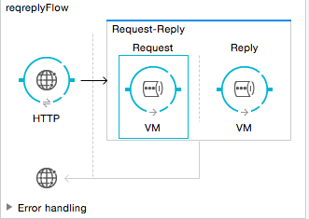
Request – Reply Pattern
Insurance provider core system will be called using request reply pattern using correlationId as system requires 2 minutes to process the request and generate the confirmed insurance.

Slide 7
Overall Architecture
Travel Booking Portal
Portal
Exp API
Experience Layer
Policy
Process API
Quote
Process API
Process Layer
Insurance
System API
System Layer
Insurance Provider System

Slide 8
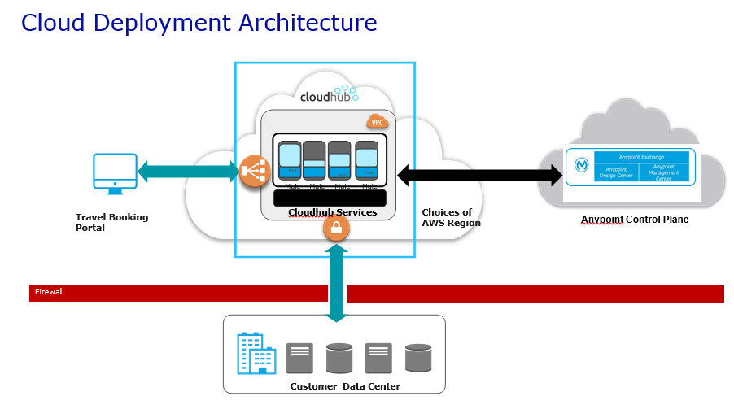

Slide 9
API Versioning
Semantic Versioning
MAJOR
MINOR
PATCH
Backward incompatible
changes
New functionality
backward compatible
Bug fixes that are
backward compatible
Approach for API versioning:
1. API version in the base path
2. API version in the application name

Slide 10
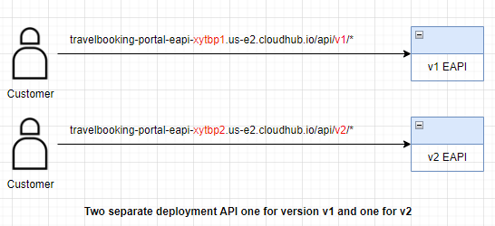
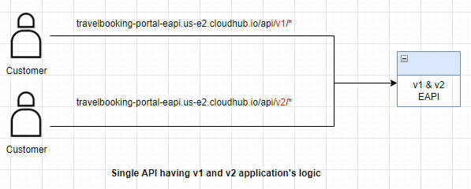
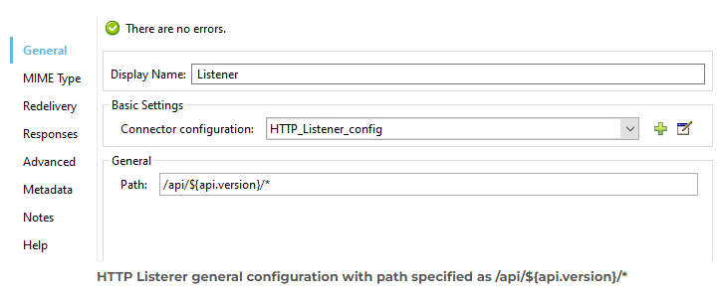
1. API version in the base path
listener configuration

Slide 11
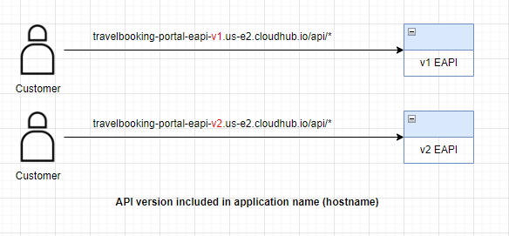
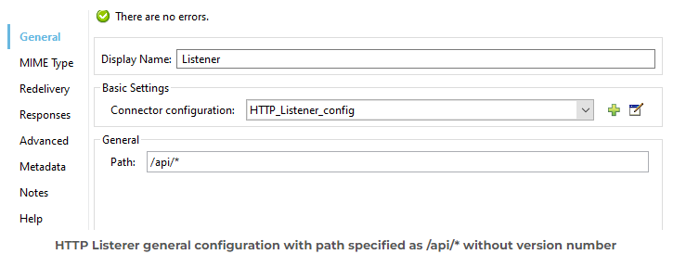
2. API version in the application name
listener configuration

Slide 12
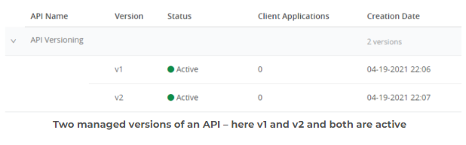
API Management of multiple versions
Note: Both version won’t share the same Auto discovery ID and you need to provide them appropriately.

Slide 13
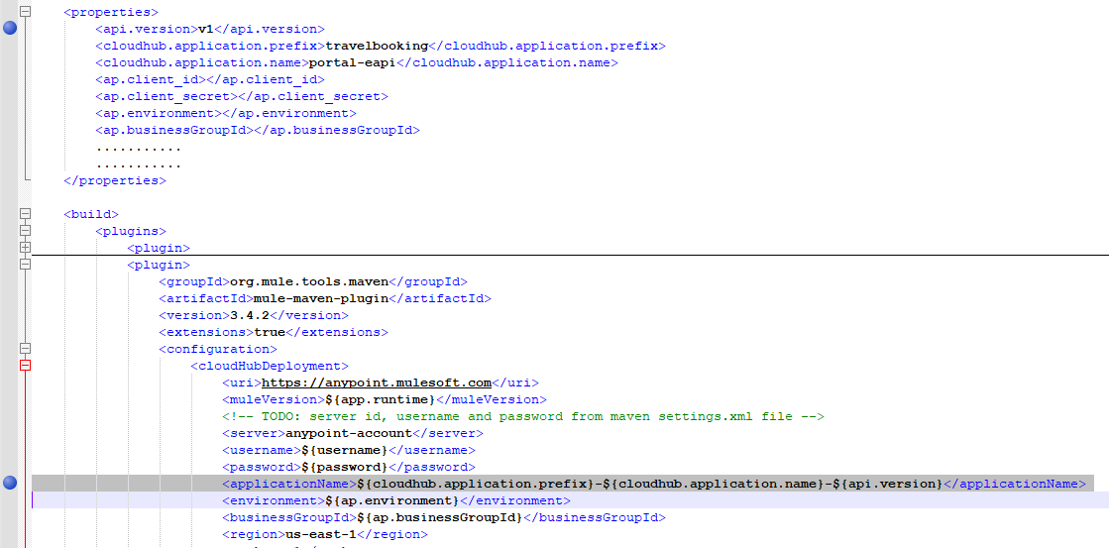
CloudHub deployment configuration

Slide 14
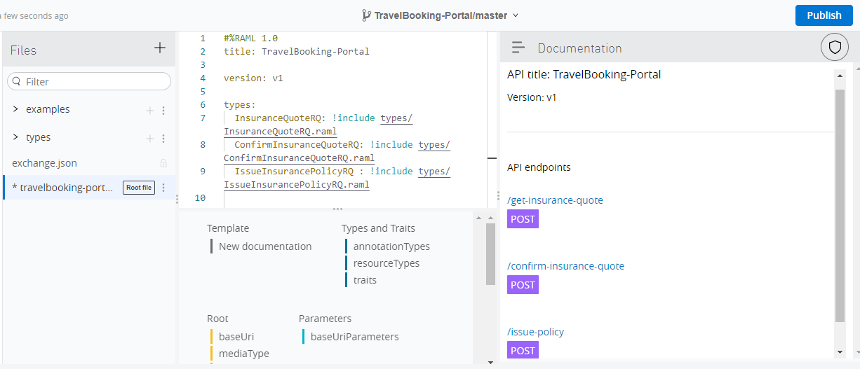
API Request and Response Messages
Refer attached file for request & response:

Slide 15
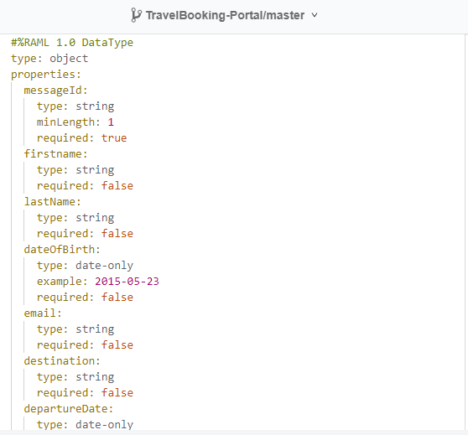
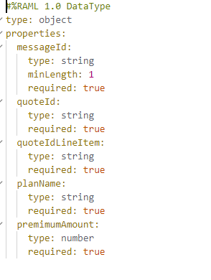
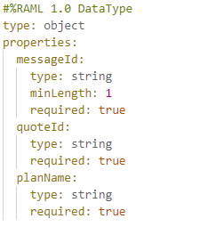
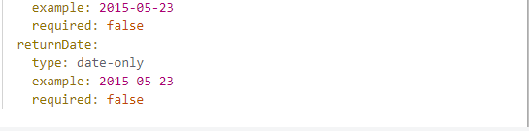
InsuranceQuoteRQ
ConfirmInsuranceQuoteRQ
IssueInsurancePolicyRQ

Slide 16
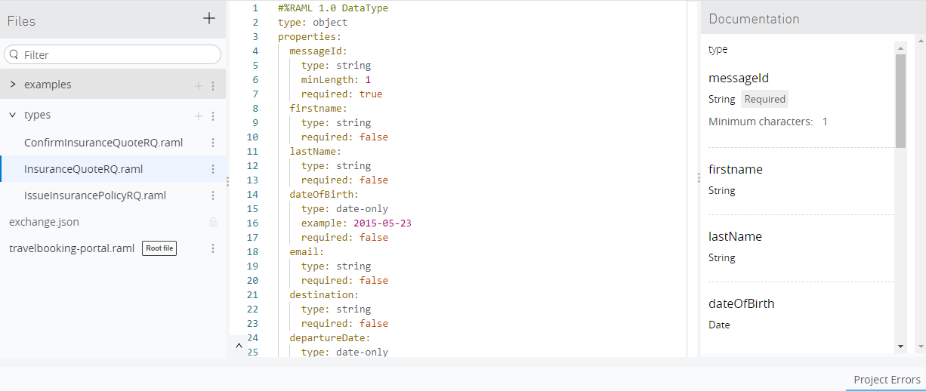

Slide 17
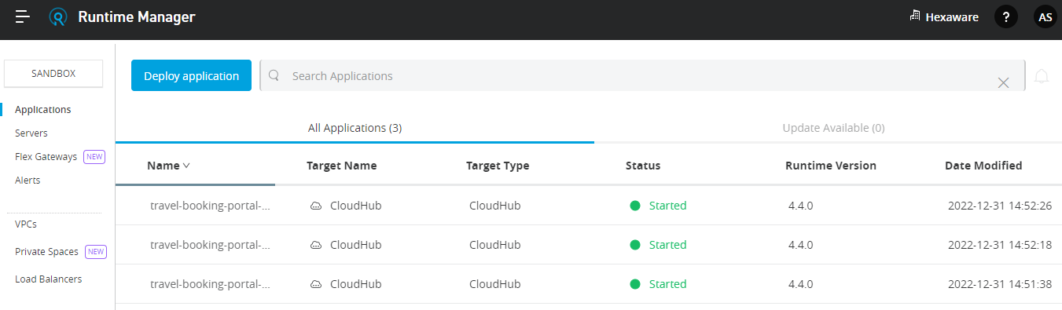
Naming Convention & URL
Project Name:
Experience Layer : travel-booking-portal-eapi-v1
Process Layer: travel-booking-portal-papi
System Layer: travel-booking-portal-sapi
URL:
https://travelbooking-portal-eapi-v1.us-e2.cloudhub.io/api/get-insurance-quote
https://travelbooking-portal-eapi-v1.us-e2.cloudhub.io/api/confirm-insurance-quote
https://travelbooking-portal-eapi-v1.us-e2.cloudhub.io/api/issue-policy

Slide 18
Q&A
1. What all fields required to send to main frame system? PI also need to pass in request?
2. Before issue a policy to customer, customer need to make payment?
3. Till what time system need to re-try in case core system is down?
4. System need to trigger email to user once quote confirmed in core system?

